Slide 1

Digital Content Management System
Resource Management Module
Devin Roering
Eric Young
Jessica Adamec
Bikash Timalsina
Subash Shrestha
Slide 1 of 16

Slide 2
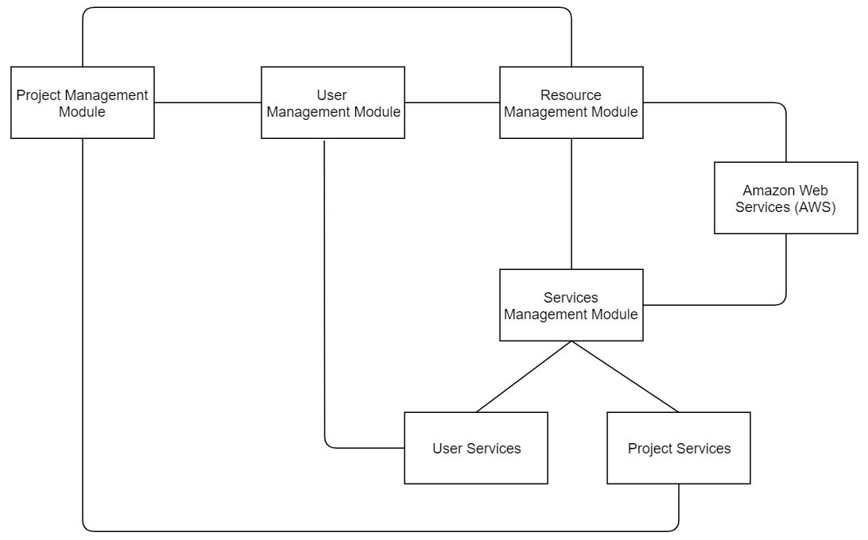
View Of Overall
Digital Content Management System
Slide 2 of 16

Slide 3
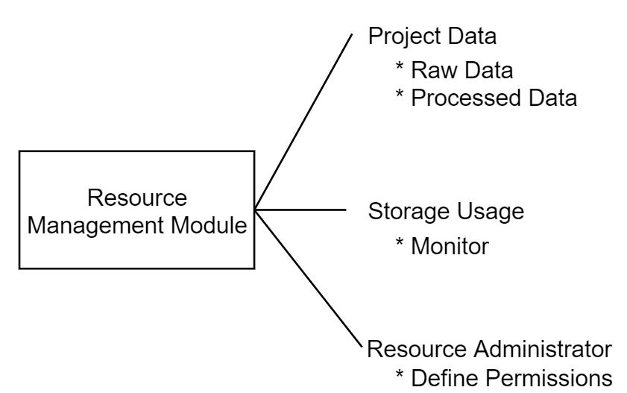
View Of Resource Management Module
Slide 3 of 16

Slide 4
Resource Management Module Purpose:
Store, allocate, and monitor resources for users and projects.
Define the Resource Administrator role for assigning and monitoring resources.
Resources include images, text, and other types of data files.
Resources may be uploaded from users or generated by Amazon Web Services (AWS).
Slide 4 of 16

Slide 5
Functional Requirements:
The Product shall store resources for users and/or projects.
The Product shall assign resources to users and/or projects.
The Product shall monitor resource usage.
Slide 5 of 16

Slide 6
Non-Functional Requirements:
Scalability:
The Product shall be able to support many users.
Security:
The Product shall secure any transmission of private information.
Data Integrity:
The Product shall interact with secure data held by AWS.
Slide 6 of 16

Slide 7
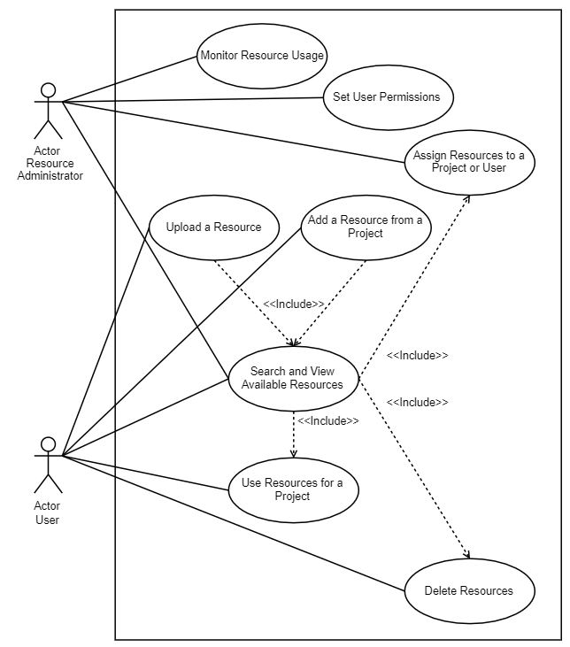
Use Case Diagram:
Slide 7 of 16

Slide 8
Scenario Name: Upload a Resource
Use-Case ID: UC-1
Actors: User
Summary: A user wants to add their own resource to the Digital Content Management System (DCMS).
Preconditions: The user must first be authorized to add resources and logged into the DCMS.
Main Sequence:
1. User navigates to the appropriate place to add resources.
2. User selects a resource file from their system to add to the DCMS.
3. DCMS checks if there is enough storage space for the file.
4. DCMS accepts file upload.
5. A record of the file upload is recorded.
Alternatives:
Step 1 A1. The user may select a resource from an existing project. This is a separate use case (UC-2).
Step 3 A1. If there is not enough storage space available, DCMS checks if the user is authorized to request additional storage. If the user is allowed to access additional storage, proceed to step 4 once the storage space has been created.
Exceptions:
Step 3 E1. No storage space is available for resources. If the user is not authorized to request more storage space, DCMS will notify the user that there is no more storage space available.
Step 5 E1. An error occurs during upload. DCMS will notify the user of the error.
Postconditions: The resource has been added to the DCMS.
Slide 8 of 16

Slide 9
Scenario Name: Add a Resource from a Project
Use-Case ID: UC-2
Actors: User
Summary: A user wants to add a resource to the Digital Content Management System (DCMS) from an existing project.
Preconditions: The user must first be authorized to add resources and logged into the DCMS.
The project resource must already exist.
Main Sequence:
1. User navigates to the appropriate area to save resources.
2. User selects the resource file to add to the DCMS.
3. DCMS checks if there is enough storage space for the file.
4. DCMS accepts the file to save.
5. A record of the file save is recorded.
Alternatives:
Step 4 A1. If there is not enough storage space available, DCMS checks if the user is authorized to request additional storage. If the user is allowed to access additional storage, proceed to step 4 once the storage space has been created.
Exceptions:
Step 3 E1. No storage space is available for resources. If the user is not authorized to request more storage space, DCMS will notify the user that there is no more storage space available.
Postconditions: The resource has been added to the DCMS.
Slide 9 of 16

Slide 10
Scenario Name: Use Resources for a Project
Use-Case ID: UC-4
Actors: User
Summary: A user wants to use resources for a project.
Precondition: The user must first be authorized to use resources for a project and logged into the Digital Content Management System (DCMS). A project must already exist, else the user must be authorized to create a new project. A resource must have already been added (UC-1 or UC-2). A user must have already searched and viewed existing resources (UC-3).
Main Sequence:
1. User selects the resource they wish to use for a project.
2. User searches for the available project they wish to use the resources for.
3. DCMS displays the available projects.
4. User selects the project they wish to use the resources for.
5. DCMS assigns the resources to the specific project.
6. A record of the resource assignment is made.
Alternatives:
Step 2 A1. The user may create a new project if they are authorized to do so. This is handled by the Project Management Module. Once the new project is created, Skip to step 5.
Exceptions:
Step 1 E1. No resources are available. DCMS will inform the user that no resources are available.
Step 3 E1. No project matches the user search. DCMS will inform the user that there was no match.
Postconditions: The resources have been assigned to the project.
Slide 10 of 16

Slide 11
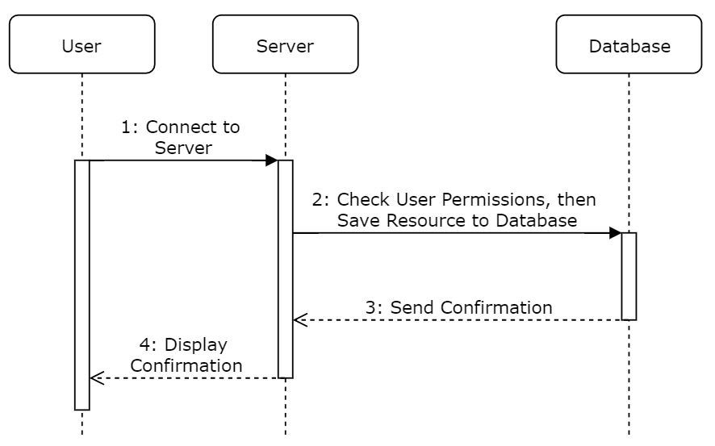
The Logical View
Sequence Diagram – Upload a Resource:
Slide 11 of 16

Slide 12
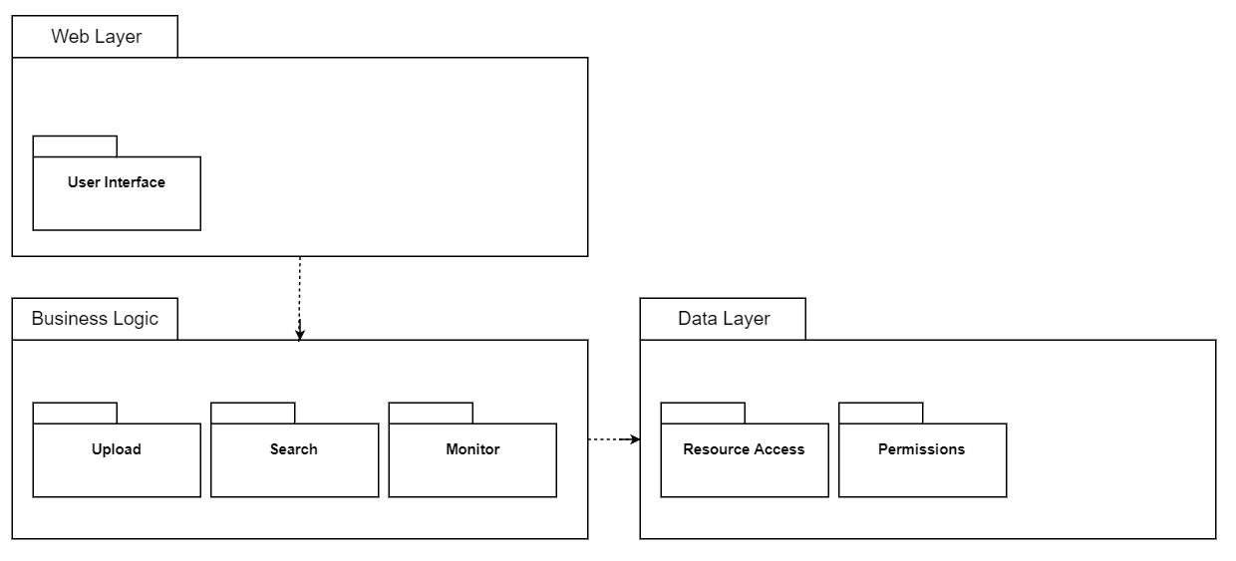
The Development View - Package Diagram :
Slide 12 of 16

Slide 13
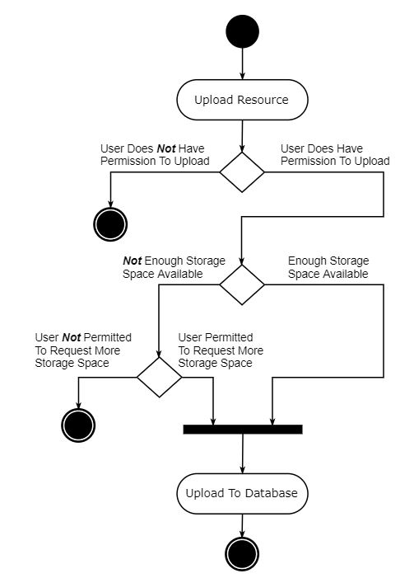
The Process View - Activity Diagram – Upload a Resource:
Slide 13 of 16

Slide 14
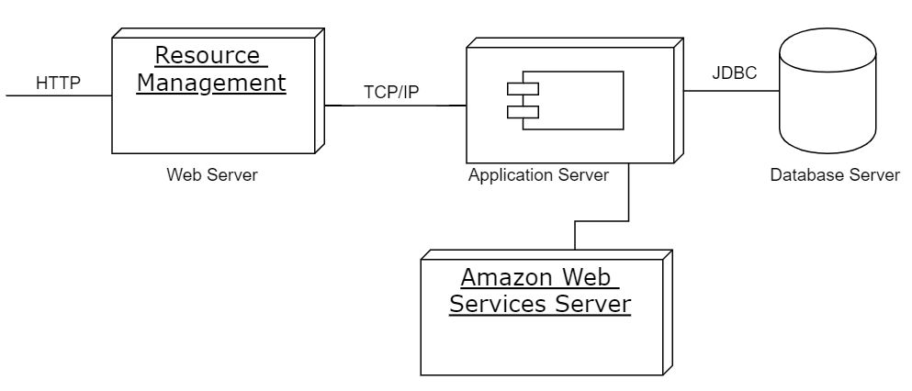
The Physical View - Deployment Diagram:
Slide 14 of 16

Slide 15
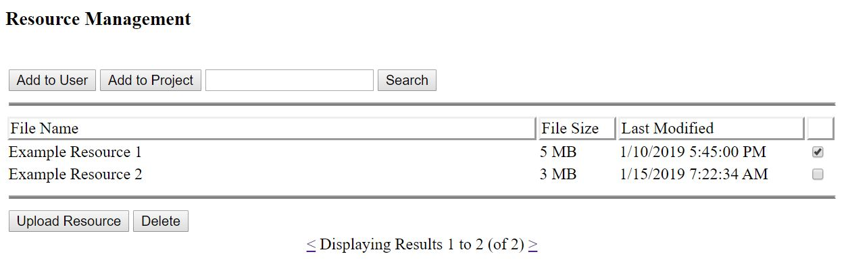
User Interface View:
Slide 15 of 16

Slide 16
Questions?
Slide 16 of 16

